Slide 1
Execution Plan Videos What we will cover
Types of Operators:
https://technet.microsoft.com/en-us/library/ms175913(v=sql.105).aspx
Table Scan
Clustered Index Scan
Clustered Index Seek
Non-clustered Index Seek
Compute Scalar
Adding a WHERE Clause
Filter
Sort
Table Joins :
  Nested Loops Join
  Hash Match (Join)
  Merge Join
Key LookUp
RID LookUp
DML statements:
  Insert
  Delete
  Update

Slide 2
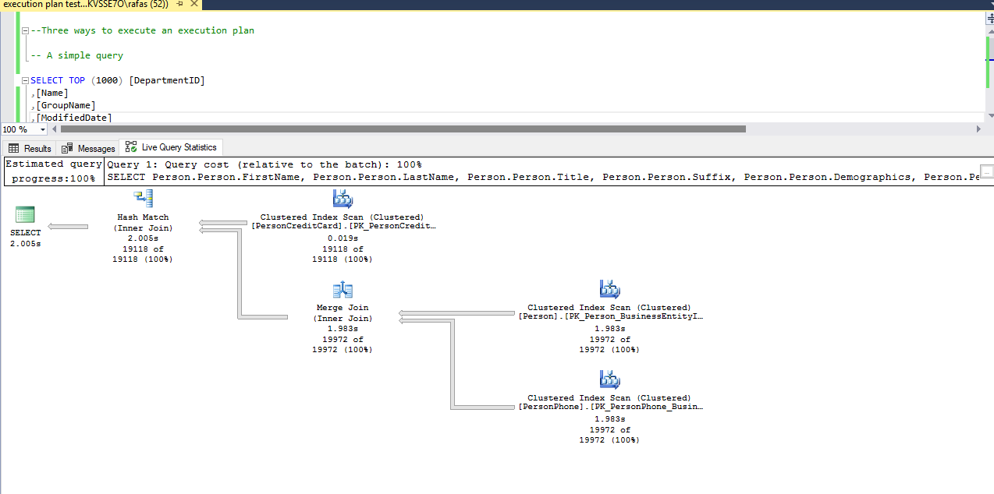
Reading the Execution Plan
You can read the Execution Plan (EP) either from right to left OR left to right
When reading from left to right – you are asking what are the commands to get the data
When reading from right to left– you are asking what is the flow of the data
The thickness of the arrows shows the count of rows

